Slide 1
C#
Survival, Inquiry, Sophistication
Azure
WP7
Win 8
Android
iPhone
iPad

Slide 2

Survival, Inquiry, Sophistication
How can we eat?
Why do we eat?
Where shall we have lunch?
“The History of every major Galactic Civilization tends to pass through three distinct and recognizable phases, those of Survival, Inquiry and Sophistication, otherwise known as the How, Why, and Where phases. For instance, the first phase is characterized by the question 'How can we eat?' the second by the question 'Why do we eat?' and the third by the question 'Where shall we have lunch?”
― Douglas Adams, The Restaurant at the End of the Universe

Slide 3
Survival, Inquiry, Sophistication
How can we eat?
Why do we eat?
Where shall we have lunch?
C#
“The History of every major Galactic Civilization tends to pass through three distinct and recognizable phases, those of Survival, Inquiry and Sophistication, otherwise known as the How, Why, and Where phases. For instance, the first phase is characterized by the question 'How can we eat?' the second by the question 'Why do we eat?' and the third by the question 'Where shall we have lunch?”
― Douglas Adams, The Restaurant at the End of the Universe

Slide 4

Coming up…
C# Cloud
C# Clients
C# Cloud-Client Communication
C# Code
Real App Examples
Q&A
Session Check In:

Slide 5
C#

Slide 6
Why C#?
You already have:
skills
tools
Code
“low level”
compiles
testable
Quick
Common platform across mobile and cloud
Enables native look and feel on all platforms
Generics, Linq, Async and the future…

Slide 7
Why Azure?
Storage – lots of it
Connectivity – lots of it. Continuous. Global
Processing – lots of it. Scalable. Burstable.
Privacy/Security
Quick updateability
Toys – ACS, Queueing, CDN, TrafficManager, Caching, Services, …

Slide 8
Azure is BIG and CHEAP, but:
not INFINITE
not FREE

Slide 9
Some Code C#

Slide 10
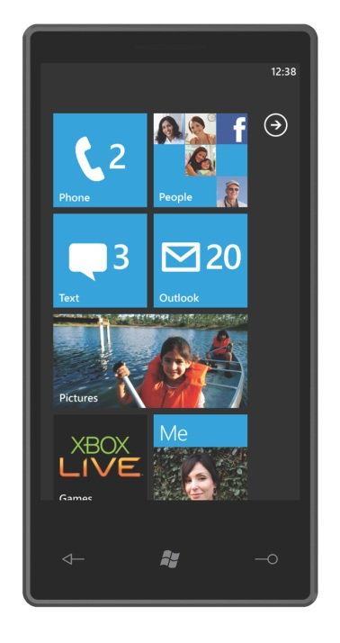
Demo Example: a TweetPic app
Azure
Website
Azure Storage
SQL
Azure

Slide 12
TweetPic Server
Server:
Storage:
Code First Entity Framework
Azure C# SDK
Logic/Services:
Custom C#
Twitterizer
Presentation:
ASP.NET MVC (Json)
WCF (oData)

Slide 13
TweetPic Server
Server:
Storage:
Code First Entity Framework
Azure C# SDK
Logic/Services:
Custom C#
Twitterizer
Presentation:
ASP.NET MVC (Json)
WCF (oData)
Lots of C# Server technologies are available:
nHibernate
RavenDB
Lucene.Net
MVC Async (+SignalR)
ServiceStack
Direct Azure Access (Secure Access Signatures)
WebAPI
OpenRasta
Simple.Web
Nancyfx
FubuMvc
ASMX and WebForms
ProtocolBuffers
…

Slide 14
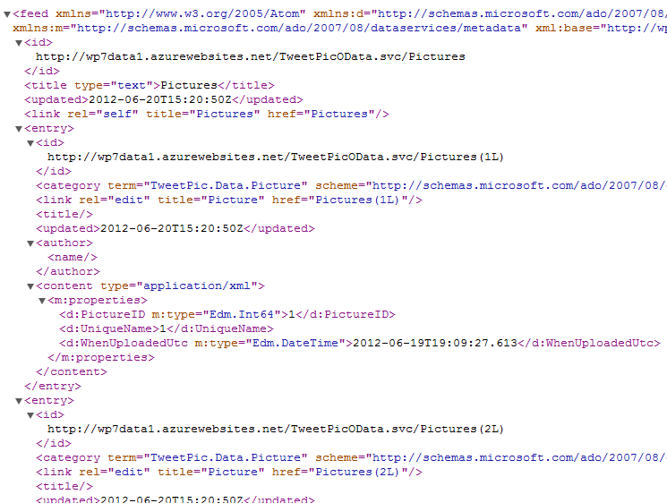
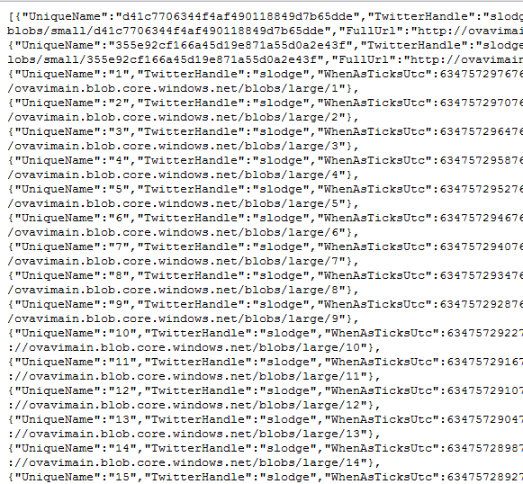

Sophistication => Size Matters!
XML list of 100 pictures
JSON list of 100 pictures
Gzip JSON list of 100 pictures
58kB
21kB
2kB

Slide 15
TweetPic Client
Service Consumption
Local Data/Services
Business Logic
UI Logic - ViewModels
Presentation
(WP7 – XAML)

Slide 16
TweetPic Client
Service Consumption
Local Data/Services
Business Logic
UI Logic- ViewModels
Presentation
(WP7 – XAML)
Presentation
(Droid – AXML)

Slide 17
TweetPic Client
Service Consumption
Local Data/Services
Business Logic
UI Logic- ViewModels
Presentation
(WP7)
Presentation
(iOS)
Presentation
(Droid)
Presentation
(Win8)

Slide 18
Some Examples C#

Slide 19
Real World Example: Lottery Results app
Push
Web Role
Worker Role
Storage

Slide 20
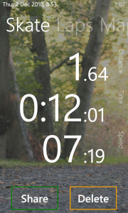
RunSat
SQL Server
ConventionallyHosted
Web Site
Blob Storage

Slide 21
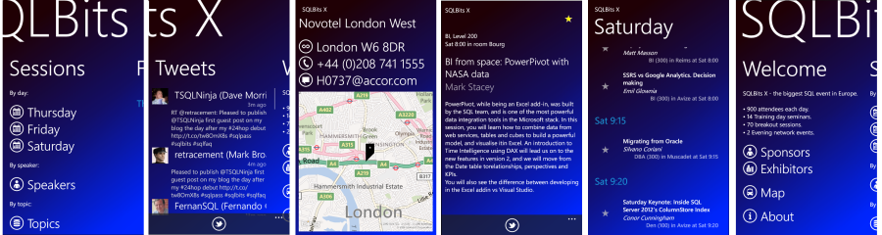
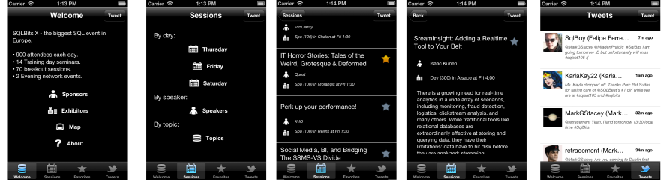
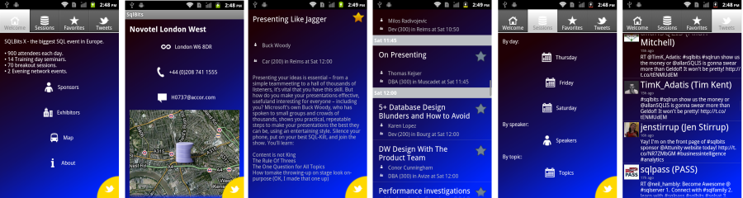
Conference App

Slide 22
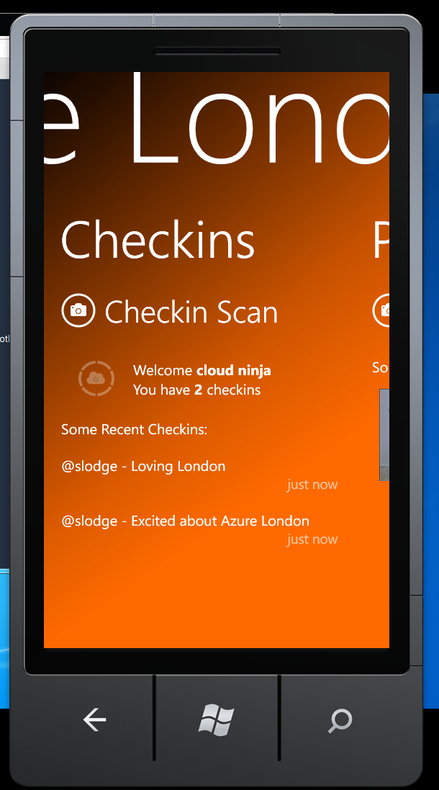
Azure London Conference App
Session Check In:

Slide 23
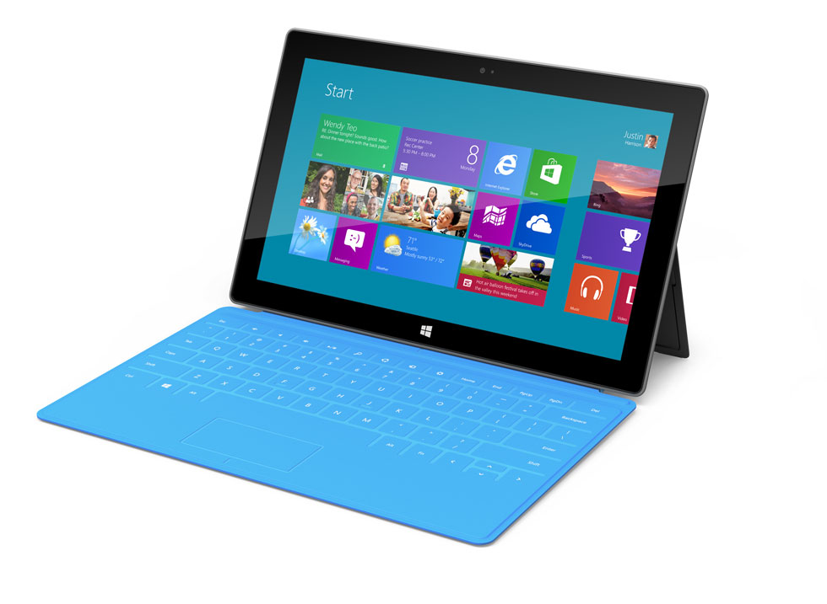
Azure London Conference App … including WinRT
Azure Server based
Service Download
Twitter Authentication
Checkin
Checkin Scoreboards
Photo Upload

Slide 24

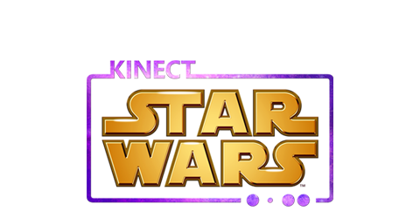

Xbox Advertising Apps

Slide 25
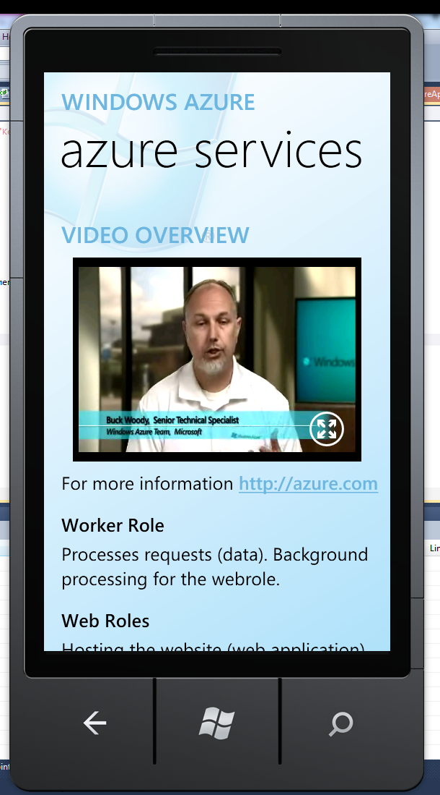
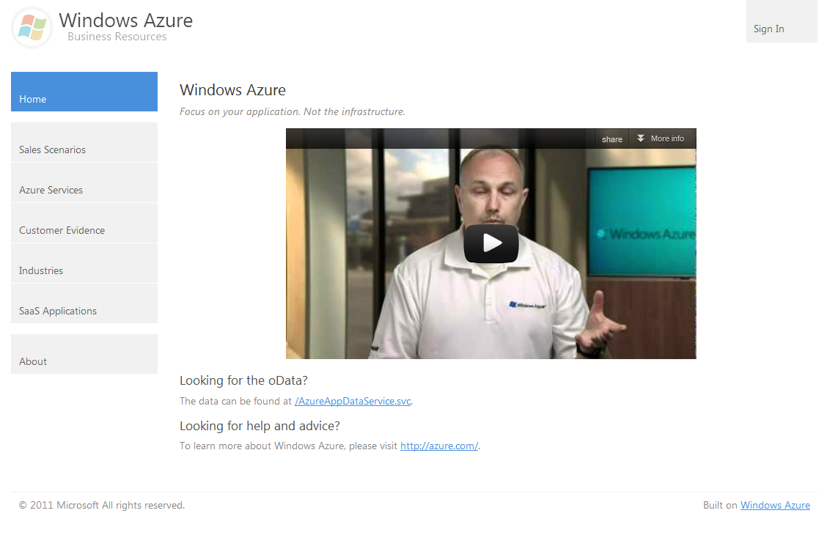
AzureApp

Slide 26
Wrap Up C#

Slide 27

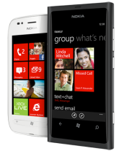
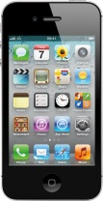

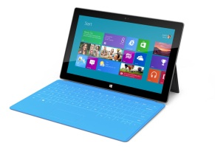
Data Access
Business Logic
Presentation
Service Consumption
Local Data/Services
Business Logic
UI Logic
Presentation
(WP7)
Presentation
(iOS)
Presentation
(Droid)
Presentation
(Win8)

Slide 28
C#
Data Access
C#
C#
Business Logic
C#
C#
Presentation
C#
C#
C#
Service Consumption
Local Data/Services
C#
C#
C#
Business Logic
C#
C#
UI Logic
C#
Presentation
(WP7)
Presentation
(iOS)
Presentation
(Droid)
Presentation
(Win8)
C#
C#
C#
C#

Slide 29
For more info…
For Server:
azure.com ☺
Wade Wenger’s talks on WP7/Android/iOS toolkits
watwp.codeplex.com
Cross platform:
msdn.com ☺
Check out the Xaminars from Xamarin
Books from @ChrisNTR and @Gshackles
Github.com/slodge/mvvmcross

Slide 30


@slodge

Slide 34
pass through
www
www
wcf
sockets
push

Slide 35
TweetPic Example
Mobile:
Storage:
File IO
(SQLite and SQLCe available!)
Logic/Services:
Custom C#
JSON.Net
Presentation:
WP7 SDK
Mono4Android
Server:
Storage:
Code First Entity Framework
Azure C# SDK
Logic/Services:
Custom C#
Twitterizer
Presentation:
ASP.NET MVC (Json)
WCF (oData)

Slide 36
Clients:
WP7 (and WP8!)
Win7 and WinRT
Silverlight
MonoMac
MonoTouch
MonoDroid
Code:
C#
.Net 2, 3.5, 4.0, 4.5
Portable Class Libraries
SQLCE and SQLite
WCF
oDataClient
JSON Clients
Sockets (e.g. ProtocolBuffers)
Server
WCF
EF, nHibernate
Etc!
So

Slide 37
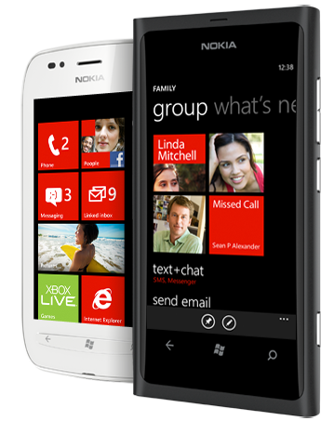

What you need – WP7:
A Windows 7 PC
Free Tools or better!
AppHub account $99
A phone sometimes helps…

Slide 38
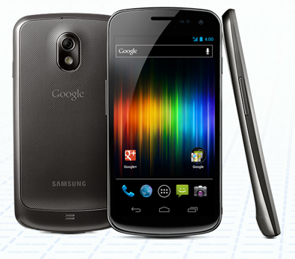
What you need - Android:
Windows PC or a Mac
Free Tools
Play account $25
A phone really helps…
Mono 4 Android $400

Slide 39

What you need - iOS:
An Intel-based Mac
Account-Linked Tools
iOS Account $99
A phone often helps…
MonoTouch - $400

Slide 40


Getting Started Links…

Slide 41
MVVM

Slide 42
Mvvm Basics
View
ViewModel
Model
View
ViewModel
Model
View
ViewModel
Model
get/set Properties
call Commands
Whatever C# you like!
notify changes
some messaging

Slide 43
MVVM Technical Details
Properties
INotifyPropertyChanged
INotifyCollectionChanged
Data Binding
IValueConverter
ICommand
UI Thread

Slide 44
Mvvm Benefits
The “normal” reasons:
Separation of concerns
Designability (Blendability)
Testability
The MvvmCross reason:
Cross platform code reuse

Slide 45
Mvvm Cross Platform
View
ViewModel
Model
View
ViewModel
Model
View
ViewModel
Model
get/set Properties
call Commands
Whatever C# you like!
notify changes
some messaging
Platform Specific
Shared

Slide 46



Some longer introductions…

Slide 47
Twitter Search

Slide 48
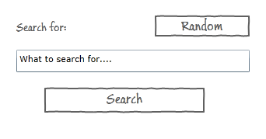

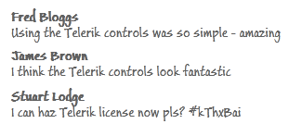
What we want to build…
Home Page:
Result Page:

Slide 49
The “core” code

Slide 50
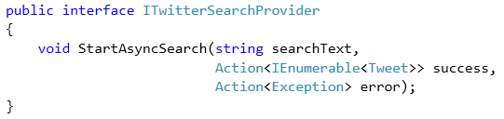
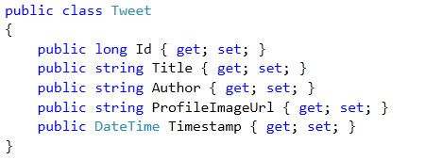
The Model and Service
STOLEN
From @ColinEberhardt

Slide 51
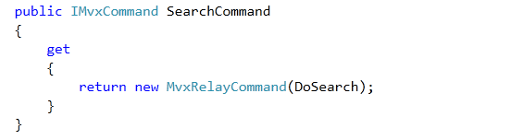
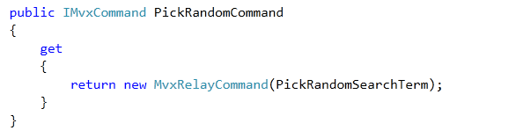
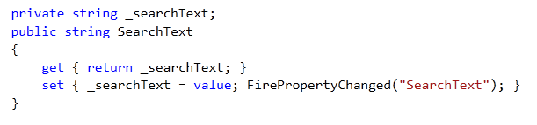
HomeViewModel

Slide 52
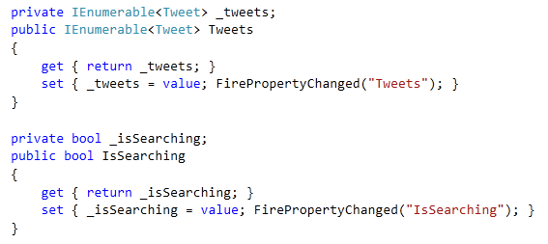
TwitterViewModel

Slide 53
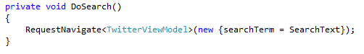
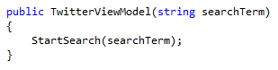
Navigation
The HomeViewModel calls:
Which means the TwitterViewModel gets created with:

Slide 54
The clients

Slide 55
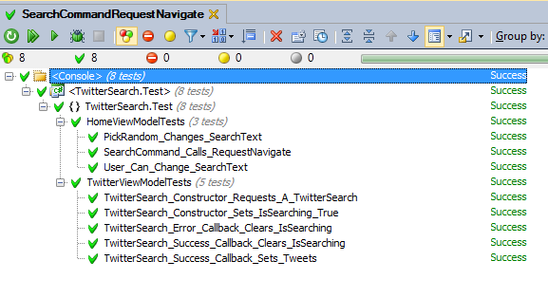
Some Unit Tests

Slide 56
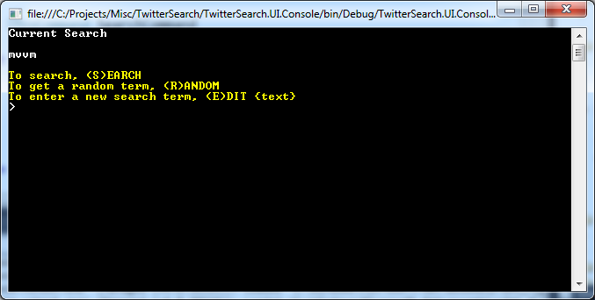
A Console App

Slide 57
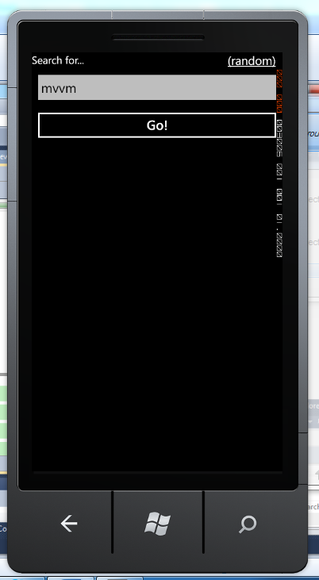
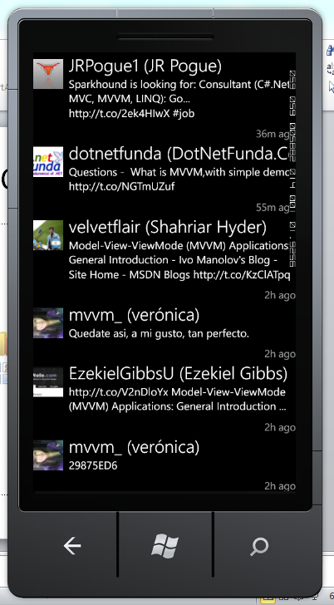
A WP7 App

Slide 58

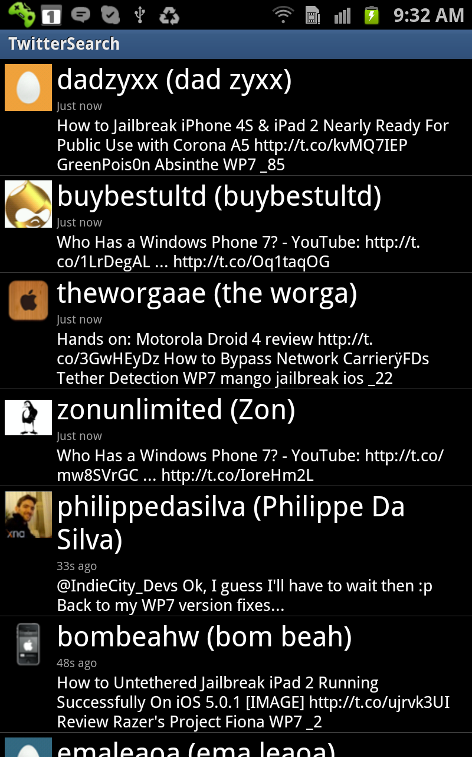
An Android App

Slide 59
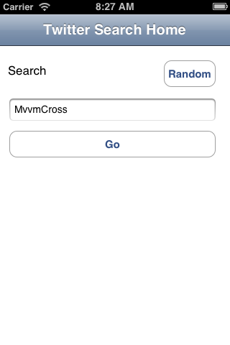

iPhone App

Slide 60

iPad App

Slide 61
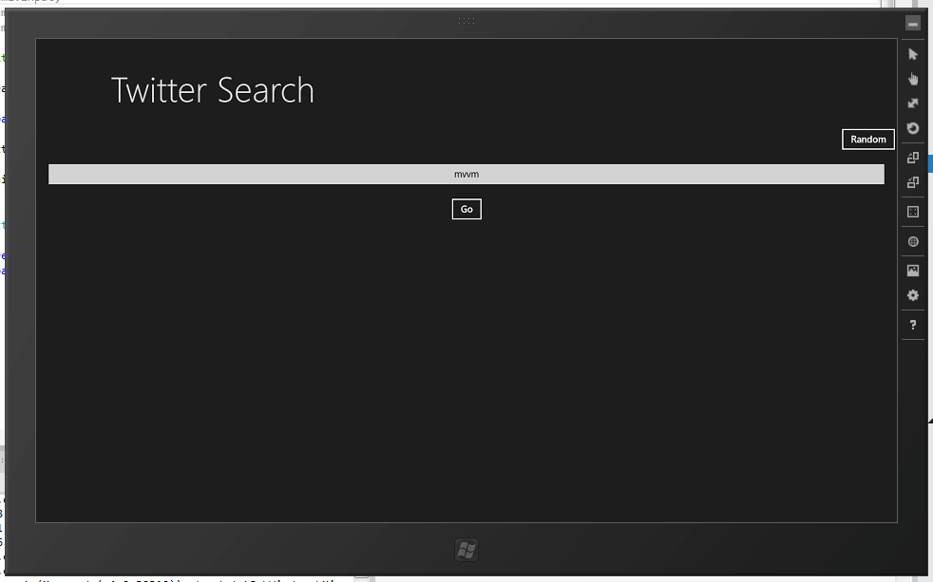
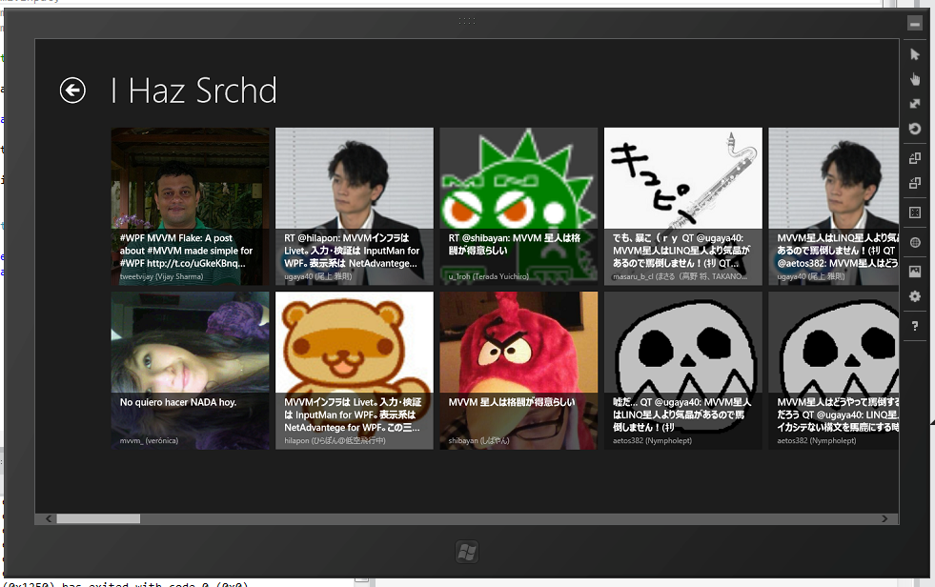
Windows 8 Metro App

Slide 62
Inside…

Slide 63
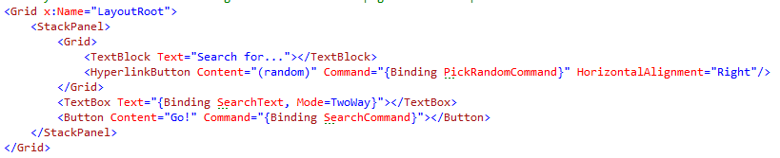
Inside WP7 App…
No C#, just XAML with {Binding}
Binding syntax includes:
{Binding Path, Converter=Converter, ConverterParameter=Parameter, Mode=Mode, FallbackValue=Fallback}

Slide 64
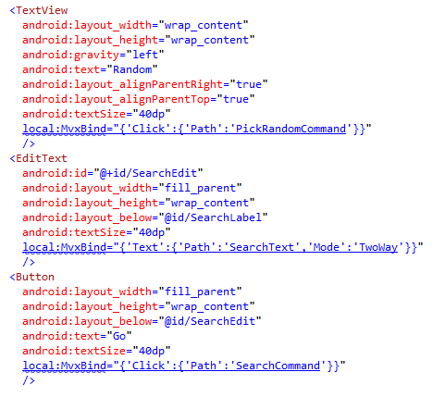
Inside Android App…
No C#, just xml with MvxBind attributes
MvxBind syntax is JSON based on XAML structure.

Slide 65
Binding – Xaml versus Mvx
WP7:
Text=“{Binding SearchText,Mode=TwoWay}”
Android:
local:MvxBind=“{‘Text’:
{‘Path’:’SearchText’,’Mode’:’TwoWay’}}”

Slide 66
Binding – Xaml versus Mvx
WP7:
Text=“{Binding Timestamp,Converter={StaticResource TimeAgo}}”
Android:
local:MvxBind=“{‘Text’:
{‘Path’:’Timestamp’,Converter’:’TimeAgo’}}”

Slide 67
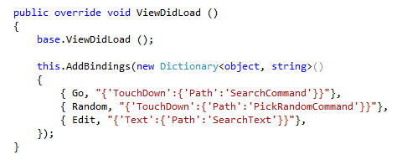
Inside iPhone App
UI is drawn in XML using Xcode
XIB is linked to C# classes using MonoTouch
Binding is declared in C# using JSON

Slide 68

Creating the XIB…

Slide 69
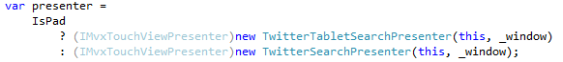
Inside iPad App
The iPad App is actually the iPhone App – “Universal”
But the UI is different – take advantage of the larger screen.
Achieved in code: IMvxTouchViewPresenter

Slide 70
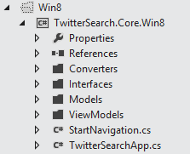
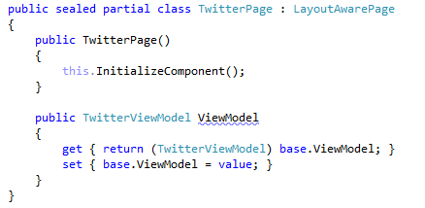
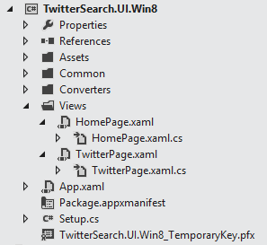
Inside Windows 8 Metro App…

Slide 71
Inside Windows 8 Metro App…
It’s like WP7….
No C#, just XAML with {Binding}
ValueConverters are used in Bindings
Lists are filled using ItemsSource
BUT: Navigation is achieved through code – not Xaml Uri’s

Slide 72

Inside Windows 8 Metro App
Warnings:
MvvmCross WinRT implementation is “first cut”
e.g. differences in ViewModel lifecycle
Under-the-hood Win8 implementation is native code – there are big differences.
differences in XAML
differences in .Net/C#
Everything is async.

Slide 73
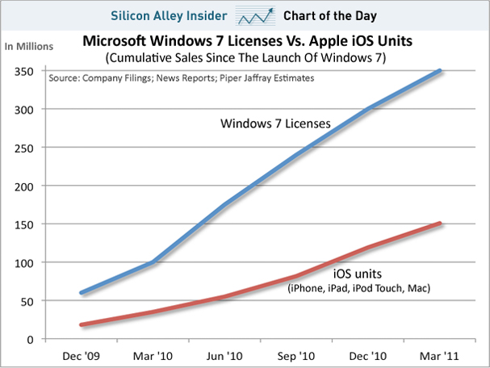
Inside Windows 8 Metro App…
Beyond the warnings – look at the numbers!

Slide 74
Recap

Slide 75
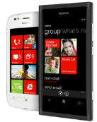
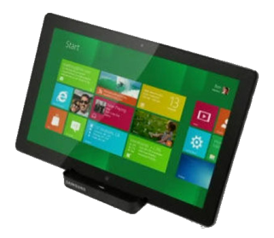

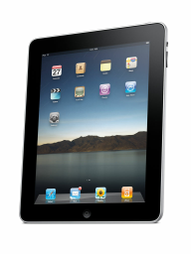

TwitterSearch recap…
Shared C# Core
ViewModels
Models
Services
Converters
Tests
UIs are “mostly XML/JSON”

Slide 76
Some Extras

Slide 78

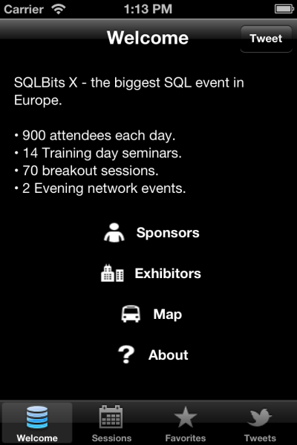
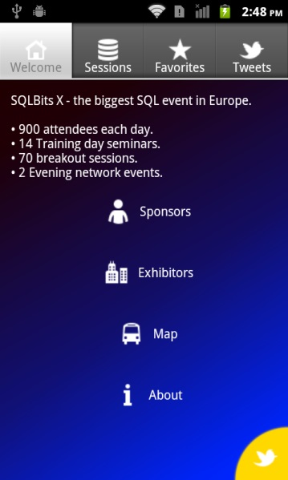
Panoramas, Pivots and Tabs
Tabbed navigation is another common metaphor across phones and across ipads too.
Generally speaking think of each “tab” as a sub-ViewModel.

Slide 79
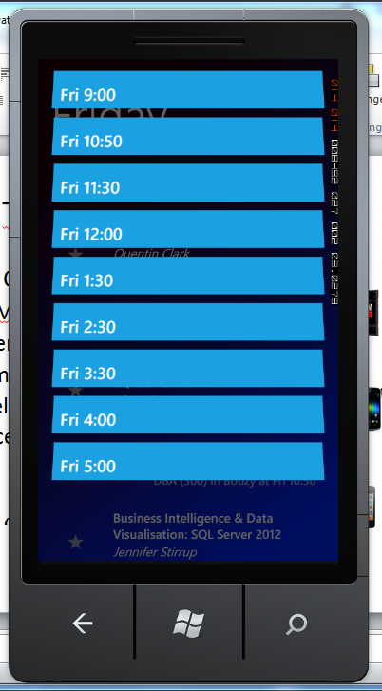
Jump Lists
Use grouped list on each viewmodel…
Each platform then works out its own format

Slide 80
Dependency Injection
Useful for testing
Essential for injecting platform specific services – e.g:
Camera capture
GPS services
NFC
MvvmCross wraps OpenNetCF DI – adds some extension methods:
RegisterServiceInstance<TService>(instance)
RegisterServiceType<TService, TServiceType>()
GetService<TService>()

Slide 81
Native Types
Sometimes #define is necessary…
Personally, I try to use interfaces and DI wherever possible.

Slide 82
i18n
Choices:
Each platform has their own localisation format available.
Xamarin are supporting .resx files…
MvvmCross provides a .json file mechanism
Or write your own

Slide 83
Blendability
Limited support available right now.
It’s relatively easy to integrate your own design time ViewModelLocator with design time data…

Slide 84
Problems?
WinRT – issues…
Xcode designer - OMG
iOS development and debugging is most painful
Some compiler differences – JIT
Multiple “core” project files annoying – and breaks refactoring
MvvmCross still changing

Slide 85
That’s all folks

Slide 86
That’s all folks…
Hopefully we covered:
C# Cross Platform
An Mvvm Introduction
Some Code: TwitterSearch
Some Extras
There might be time for:
Q&A

Slide 87

@slodge

Slide 88

http://bit.ly/mvvmcross

Slide 89

Alternatives: http://bit.ly/rrnLDT

Slide 90


Slide 91


Slide 92


Slide 93

TODO – insert big picture?

Slide 94
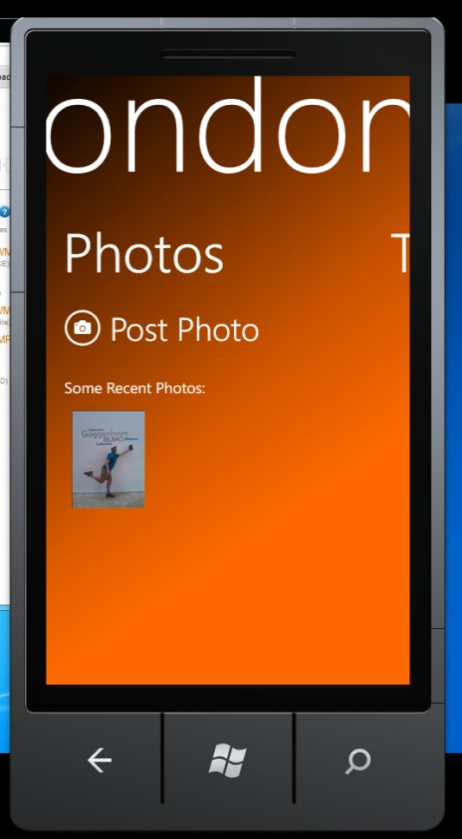
Upload your own…
From the app…
via Azure…
to the movies

Slide 95
But first…
A whole cinema screen…

Slide 96
@slodge

